Slide 1
KUBERNETES

Slide 2
objectives
Introduction to Kubernetes
Kubernetes Architecture
Pods in Kubernetes
Controllers
Services
Demo

Slide 3
Introduction to Kubernetes
What is Kubernetes?
Kubernetes is an open-source system for automating deployment, scaling the management of containerized applications.
Why Kubernetes comes into the picture?
Issues with container:
Scaling
Communication between containers
Traffic distribution

Slide 4
Introduction to Kubernetes
Features:
Self Healing
Load Balancing
Scaling and Descaling
Rollback and Rollout

Slide 5
Kubernetes Architecture
Key Components
Master
API Server
Scheduler
Control Manager
etcd
Worker Node
Kubelet
Kube-Proxy
Container

Slide 6
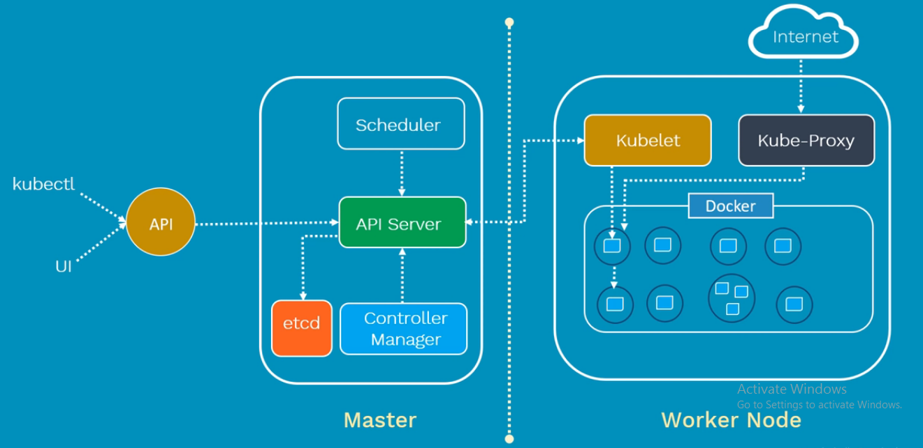
Kubernetes Architecture

Slide 7
Kubernetes Architecture
Master
Responsibilities
Manage entire cluster
Coordinate all activities
Communication with worker node
Master Components
API Server
Act as a gatekeeper
Object create, update, display, delete
API object validation and configuration
Expose operation API

Slide 8
Kubernetes Architecture
Master Components
Scheduler
Responsible for physical scheduling of pods across multiple nodes
Scheduling of pods by constraints mentioned in the configuration file
Control Manager
Node, Replication, Endpoint and Service Account Controller
All these controllers are responsible for the overall health of entire cluster
They ensure
Nodes are running and up
Correct no of pods are running as mentioned in the configuration file

Slide 9
Kubernetes Architecture
Master Components
etcd
Distributed key-value lightweight DB
Central DB to store current cluster state at any point of time
All configuration information about cluster states is stored in the etcd in the form of key/value pairs.
Any component of Kubernetes can query to etcd to understand the state of the cluster

Slide 10
Kubernetes Architecture
Worker Node Components
Kubelet
Prime node agent runs on each WN
Periodically checks the health of the containers in a pod
Looks into the pod spec that submitted to the API server on KM and ensures that containers described in that pods spec are running and healthy
If found any issues with running pods then it will restart the pod in the same node

Slide 11
Kubernetes Architecture
Worker Node Components
Kube - Proxy
Responsible for maintaining the internet network configuration
Runs in each node for load distribution among the pods and makes services available to the external host
It uses iptable rules or round robin to forward requests to the correct containers
Pod and Container
A pod is a deployment unit in the K8S with a single IP address
Act as a wrapper around containers
Container provide run-time environment for an application

Slide 12
Pods
A pod is a deployment unit in the K8S with a single IP address
Pod Deployment
Write manifest file
Manifest file consist of container images
Submit manifest file to API server
API server and scheduler will decide and deploy these pods on worker node

Slide 13
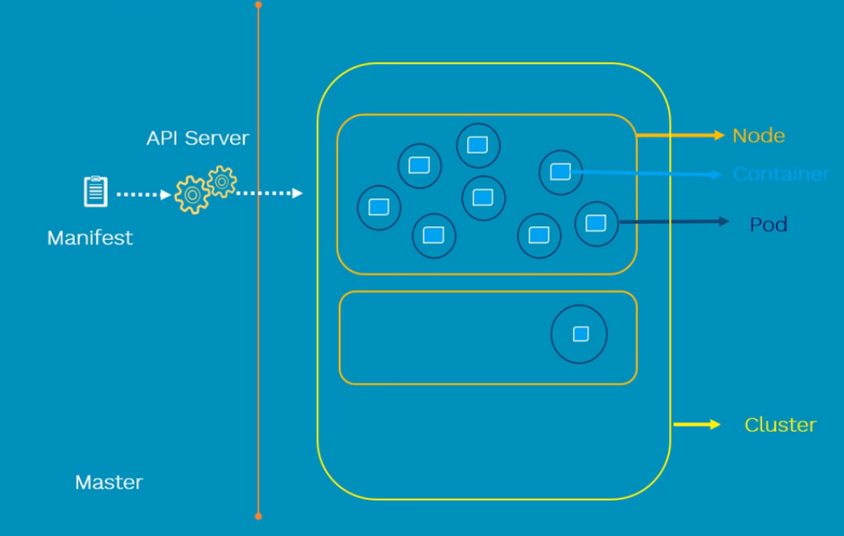
Pods
Pod Deployment

Slide 14
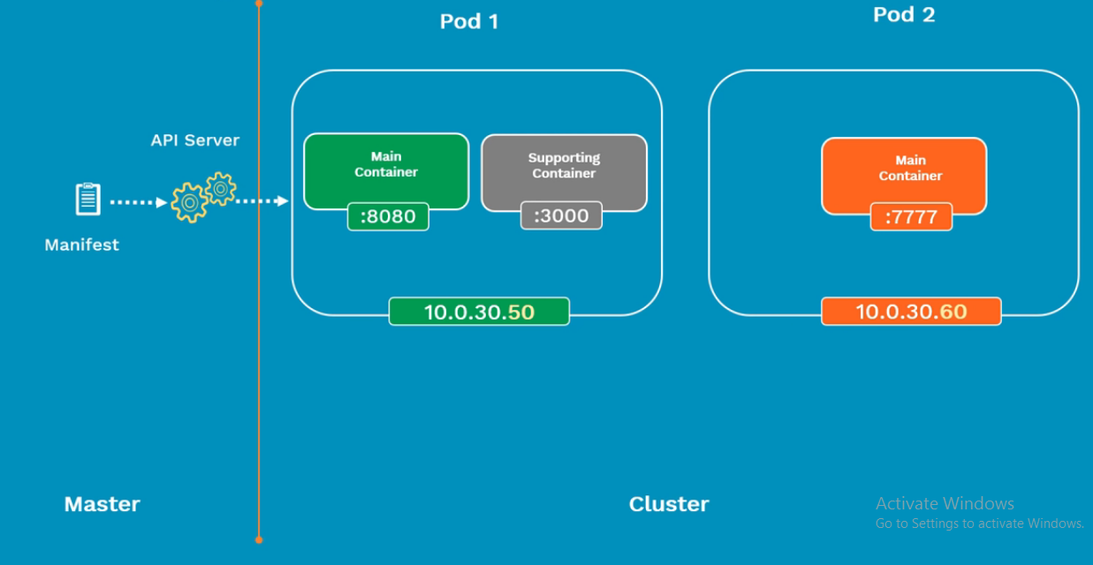
Pods
Pod Networking

Slide 15
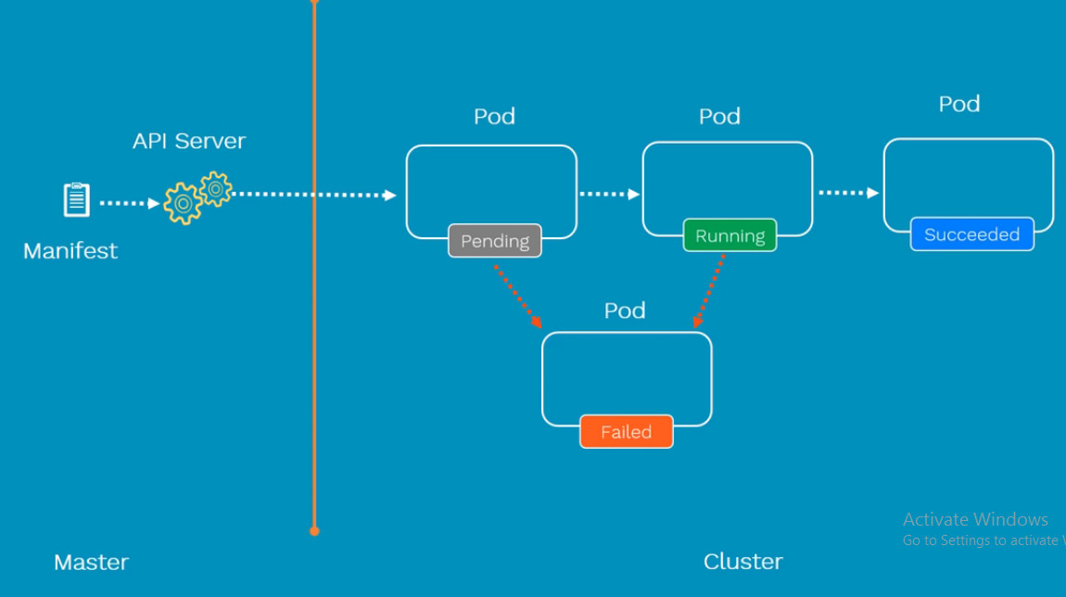
Pods
Pod Lifecycle

Slide 16
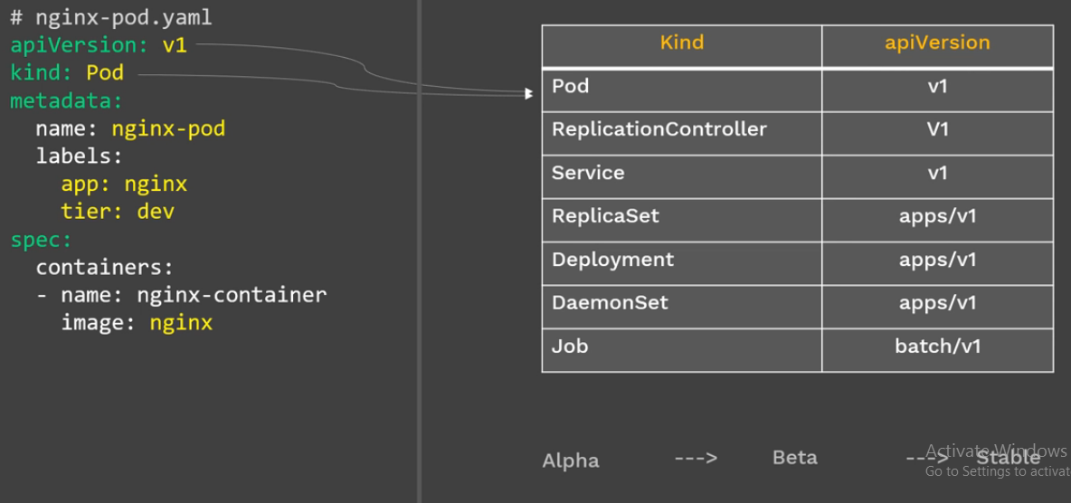
Pods
Pod Config

Slide 17
Replication controller
Ensures that a specified number of pods are running at any time
If there are excess Pods, they get killed and vice versa
New pods are launched when they get failed, get deleted or terminated
Replication controller and Pods are associated with “labels”
Creating a rc with count of 1 ensures that a pod is always available

Slide 18
ReplicaSet
Ensures that a specified number of pods are running at any time
If there are excess Pods, they get killed and vice versa
New pods are launched when they get failed, get deleted or terminated
Replication controller and Pods are associated with “labels”

Slide 19
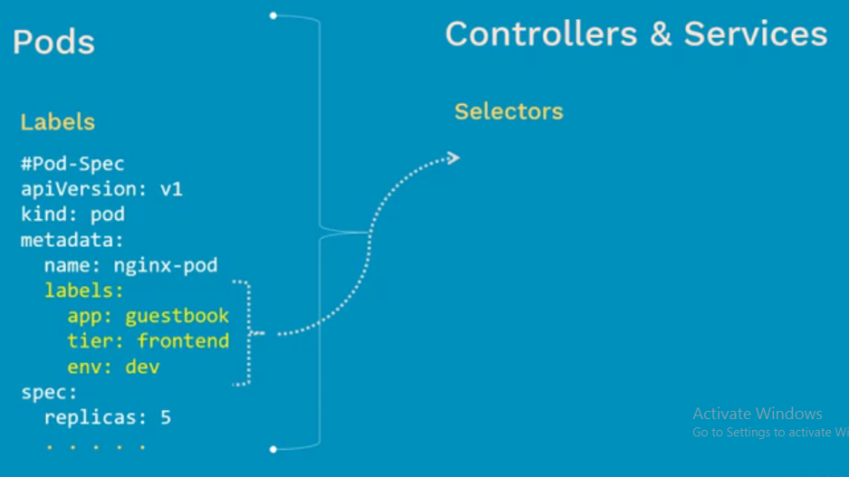
Replication controller vs Replica set
ReplicaSet is a Next-generation Replication Controller
Selectors
ReplicaSet
Supports Set-based selectors
Replication Controller
Supports equality-based
selectors

Slide 20
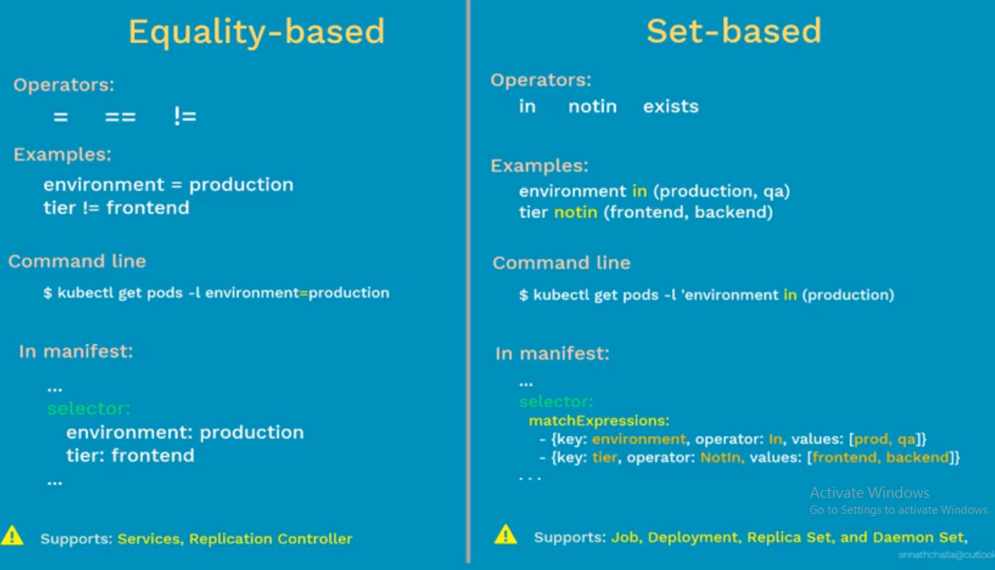
Replication controller vs Replica set

Slide 21
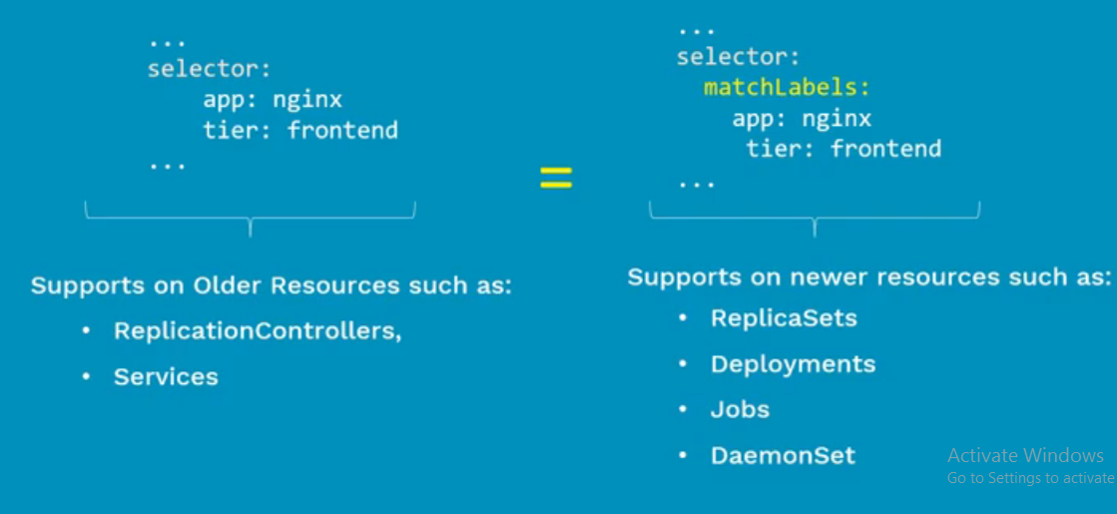
Replication controller vs Replica set
Where to use what

Slide 22
deployments
Scenario

Slide 23
Scenario
Imagine you are upgrading an application from version v1 to version v2
Upgrade with zero downtime
Upgrade sequentially, one after another
Pause and Resume upgrade process
Rollback upgrade to previous normal stable release

Slide 24
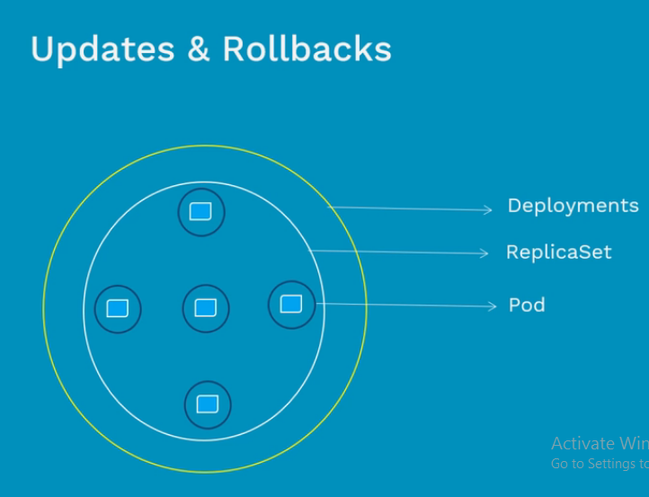
deployments
What is deployments?
It is just a controller
It all about updates and rollback
RS does not provide this upgrade and downgrade feature

Slide 25
Deployment Types
Recreate:
First shut down version v1 then start deploying version v2
Downtime is always there
Rolling-Update:
Slowly roll out the version of an application by replacing instances one after the other until all the instances successfully rolled out
Canary:
Consist of gradually shifting production traffic from v1 to v2

Slide 26
Deployment Types
Blue/Green
Version v2 which is green id deployed along with the side version v1 which is blue with exactly same amount of instances
After testing new version with all the requests, the traffic gets switched from v1 to v2 at load balancer level

Slide 27
Scenario
Imagine, you have been asked to deploy web app
How does this front end web app is exposed to the outside world?
How do front end web app is connected to backend DB?
How do we resolve Pod IP changes, when they die?

Slide 28
Services
Why we need a Service
Is it possible to have permanent IP addresses?
How do various components connect and communicate?
How do applications are exposed to outside world?
What is a Service
It is a way of grouping of pods that are running on the cluster
Features
Load balancing
Service discovery between applications

Slide 29
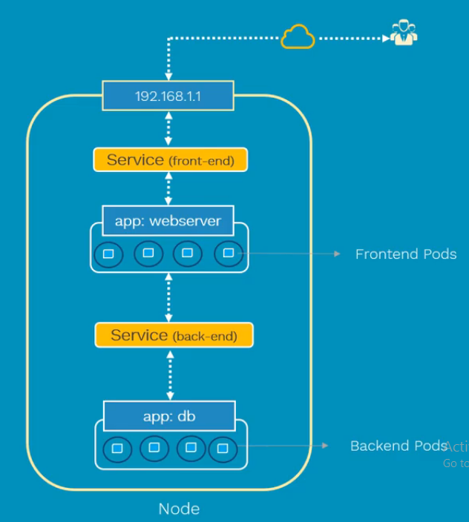
Services

Slide 30
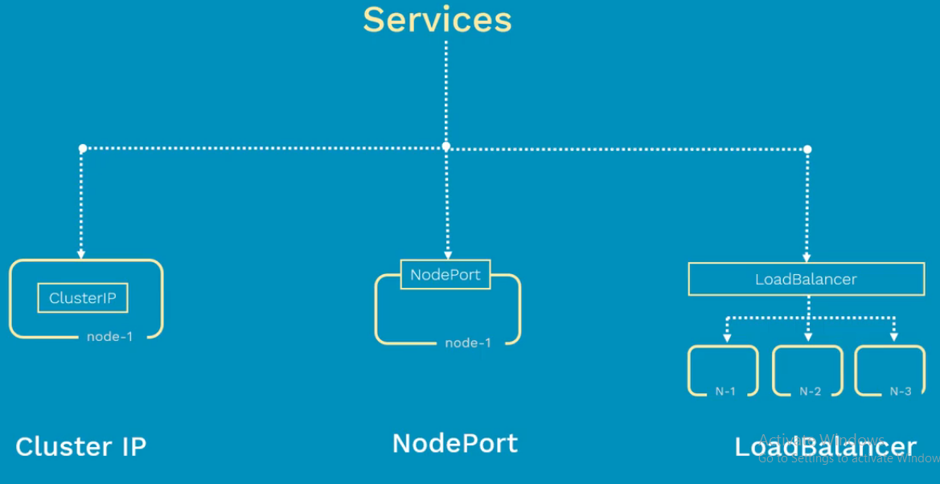
Type of Services

Slide 31
Scenario
Imagine that, you have deployed your web app on to Kubernetes cluster
Now, you need to expose it outside the world on the internet

Slide 32
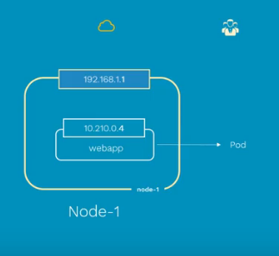
NodePort Service
Why we need NodePort?
What if pod dies
No connectivity between users and pod

Slide 33
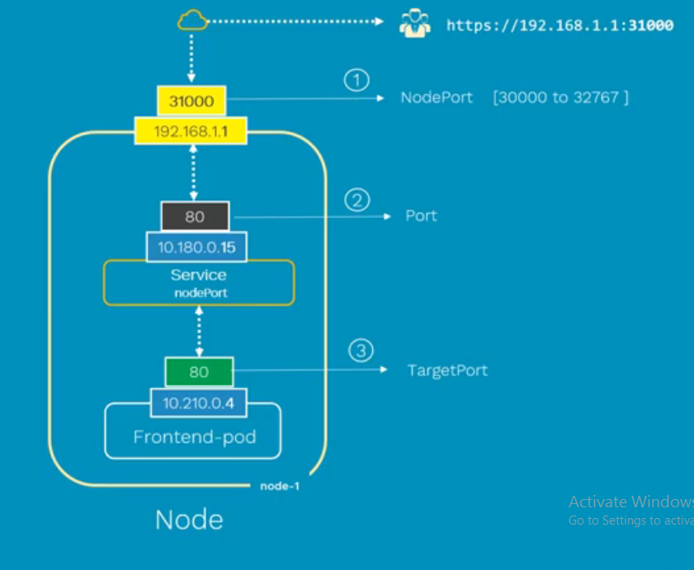
NodePort Service

Slide 34
NodePort Service
NodePort
Port on a node where pod is running
Port
Port on service itself
TargetPort
Port on actual pod where web app is running
Typically Service port and target port will be same

Slide 35
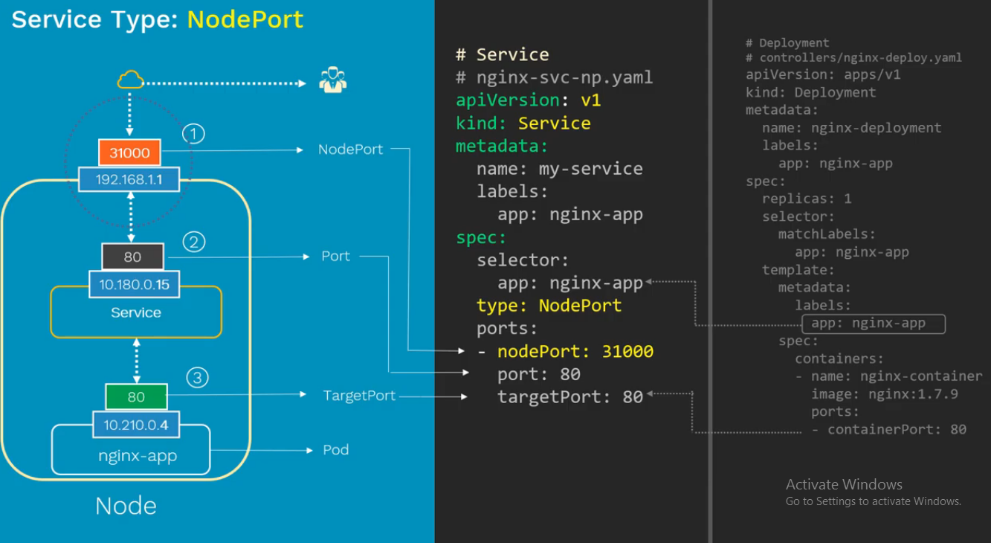
NodePort Service

Slide 36
Scenario
Imagine that, using NodePort service type you exposed your web app to outside the world on the internet
Which node IP and nodePort will you provide to end users?

Slide 37
Load Balancer service
Why we need Load Balancer Service

Slide 38
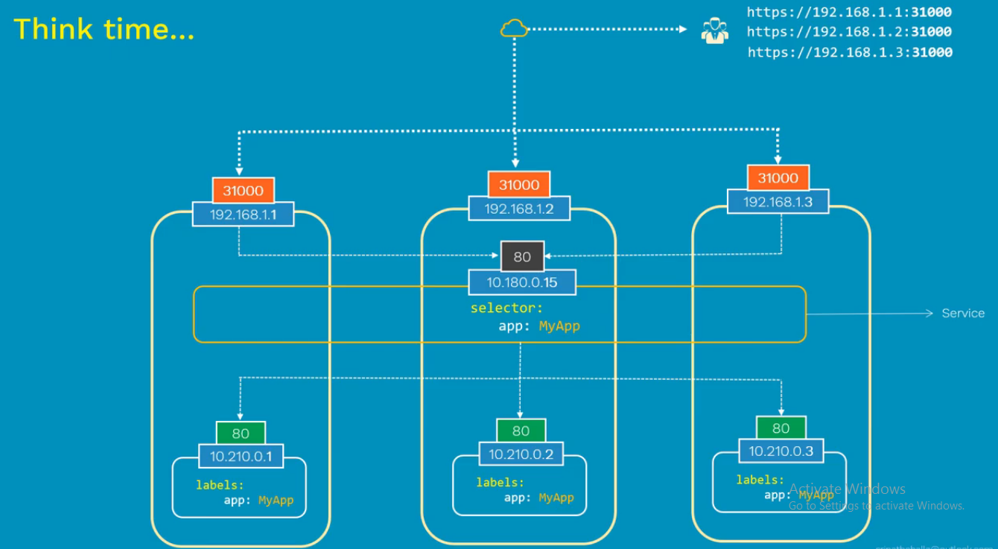
Load Balancer service

Slide 39
Load Balancer service
It is a standard goto solution to expose your application on to the internet
If you create service of type LB in AWS, Azure etc. it will create the public IP address that we can use to access your application publicly

Slide 40
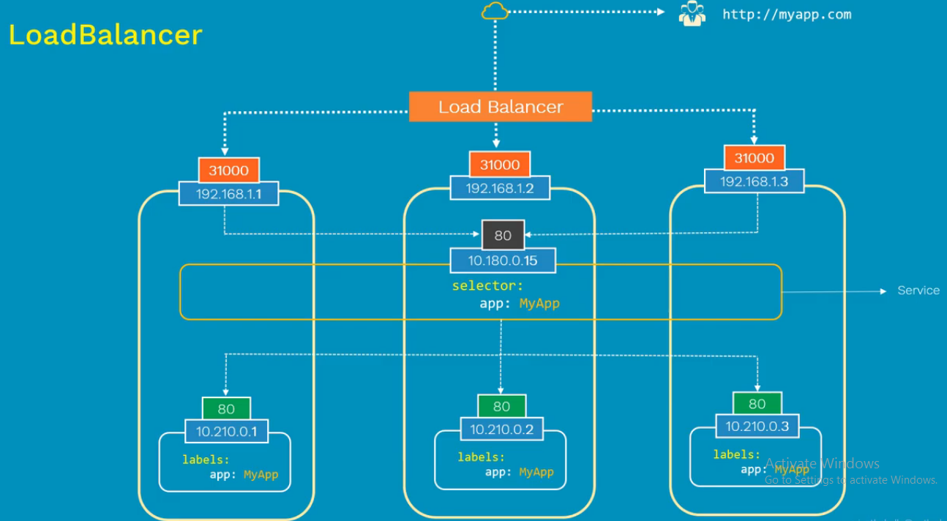
Load Balancer service

Slide 41
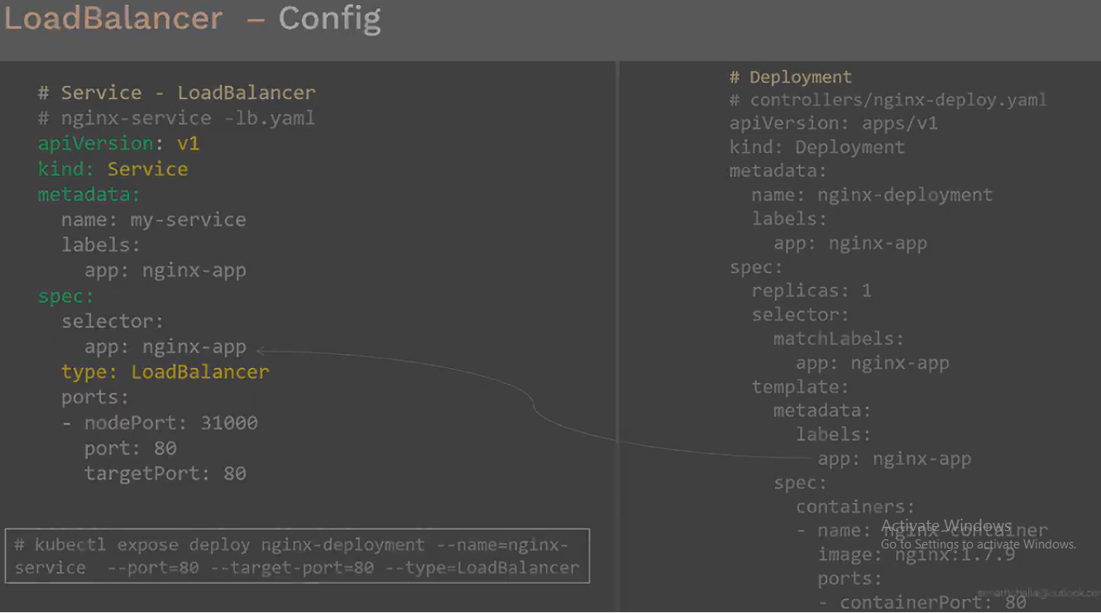
Load Balancer service

Slide 42
Scenario
Imagine that, you need to deploy one full fledge app which consists of frontend application and backed database
How can we restrict access of backend database to only within the kubernetes cluster?

Slide 43
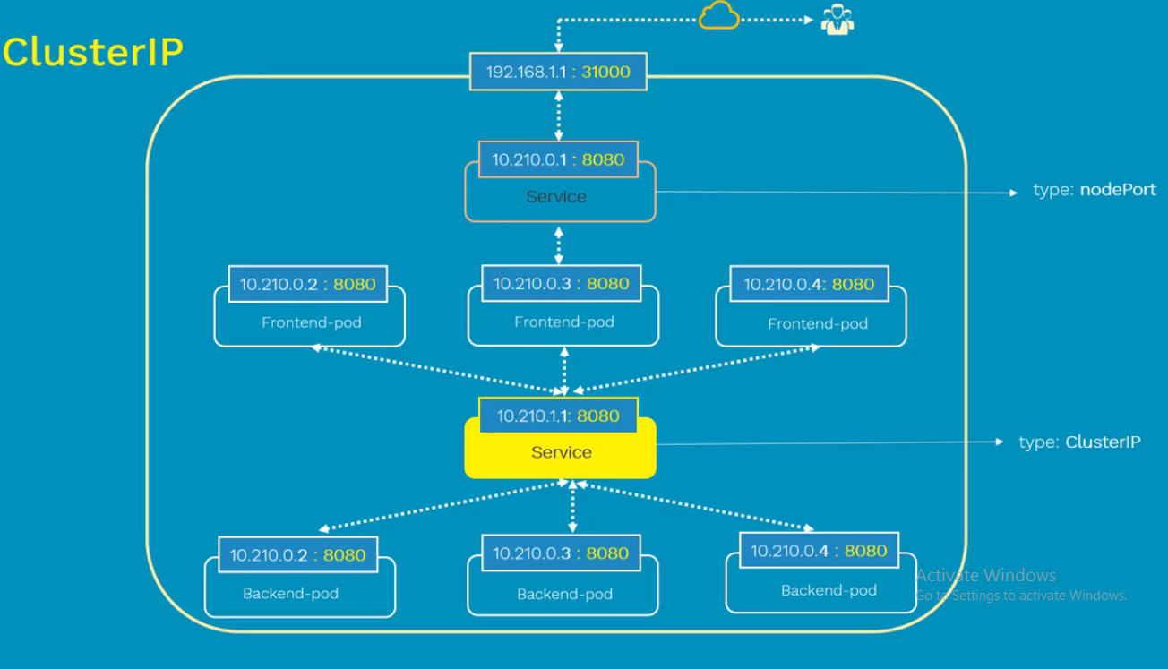
ClusterIp Service

Slide 44
Thank you!!!

